Slide 1
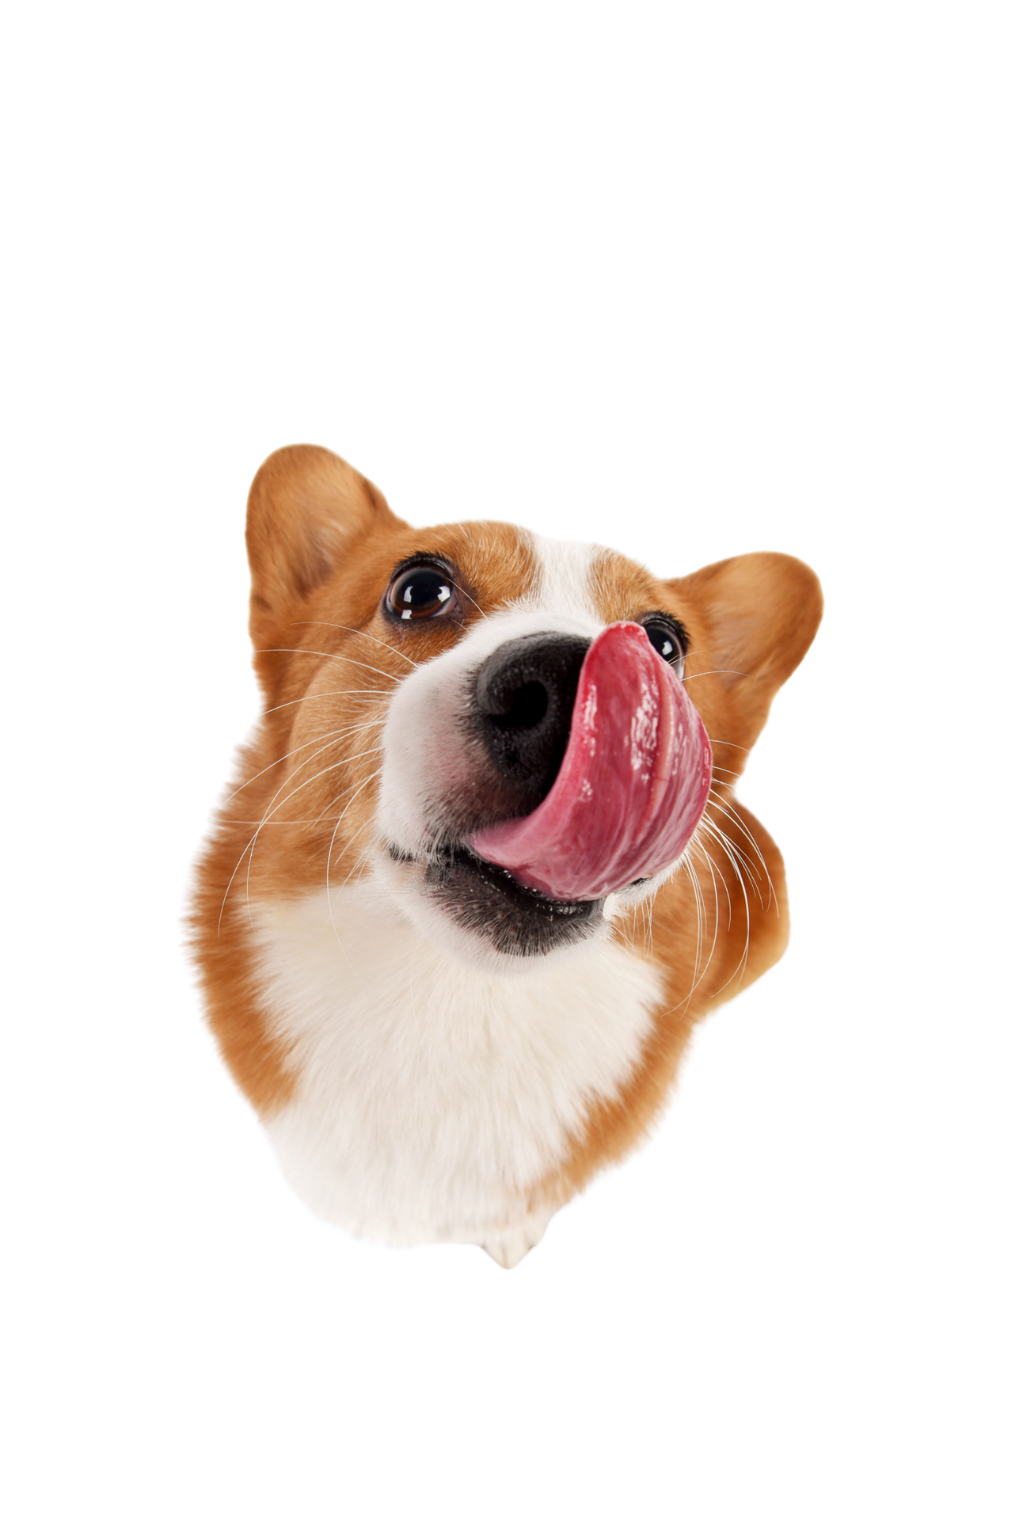
DOG BREED EXPLORER
Yeganeh Vahabi
LT2319
Notes:
my project is DogExplorer.
It's a spoken dialogue system that helps users find a dog breed that fits their lifestyle.
The idea is that users can talk naturally to the system, describe their preferences, and get recommendations and information about different breeds.

Slide 2
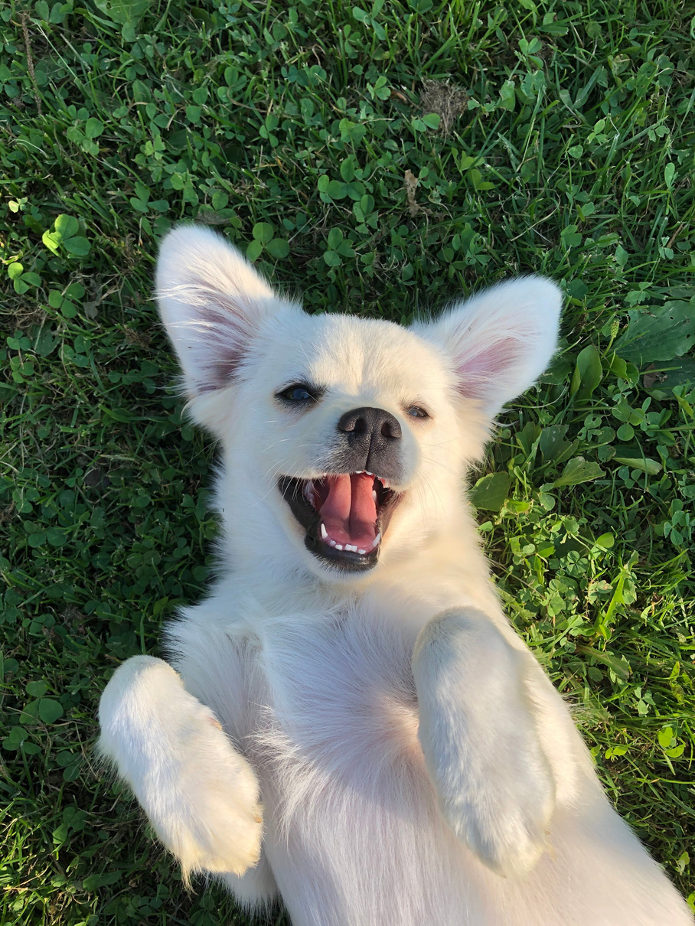
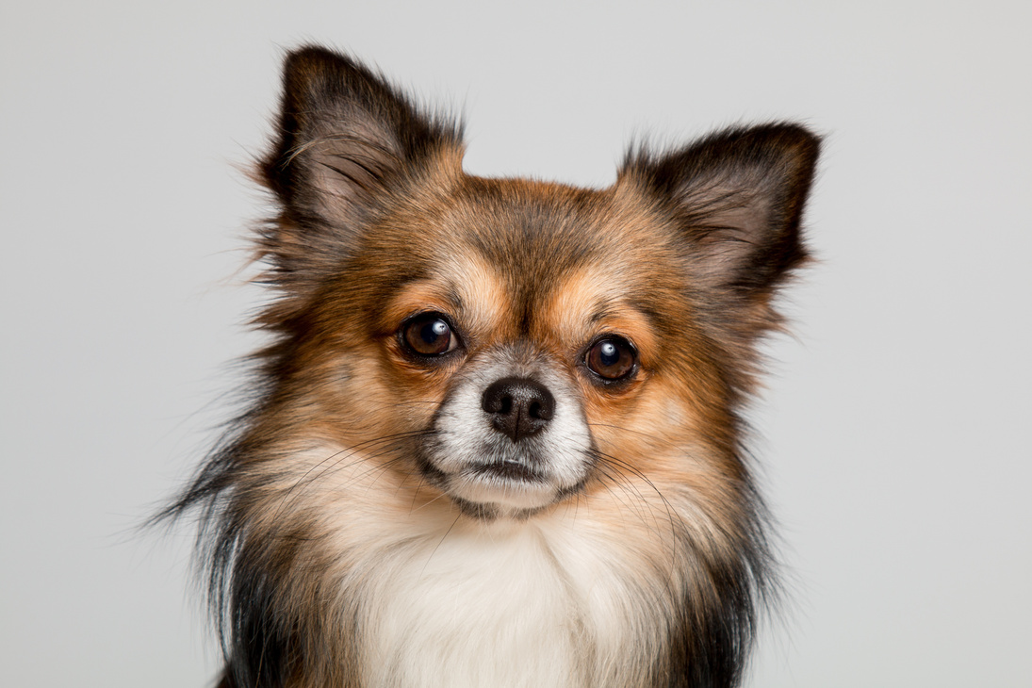
02
Introduction
You can tell it, by voice, what kind of dog would fit your life. It narrows down breeds and answers your questions about them.
  Ask
  2.Recommend
  3.Explain
Elicits size, activity level, grooming and temperament, one question at a time, or all at once.
Matches breeds from TheDogAPI and says why each one fits, three at a time.
Answers follow-up questions (“does it shed a lot?”) using retrieved breed texts.
Notes:
it has three main functions.
First, it asks questions to understand the user's preferences, such as dog size, activity level, grooming needs and temperament.
Second, it recommends matching breeds, up to three at a time.
Third, users can ask follow-up questions about a breed, and the system provides more detailed information.

Slide 3
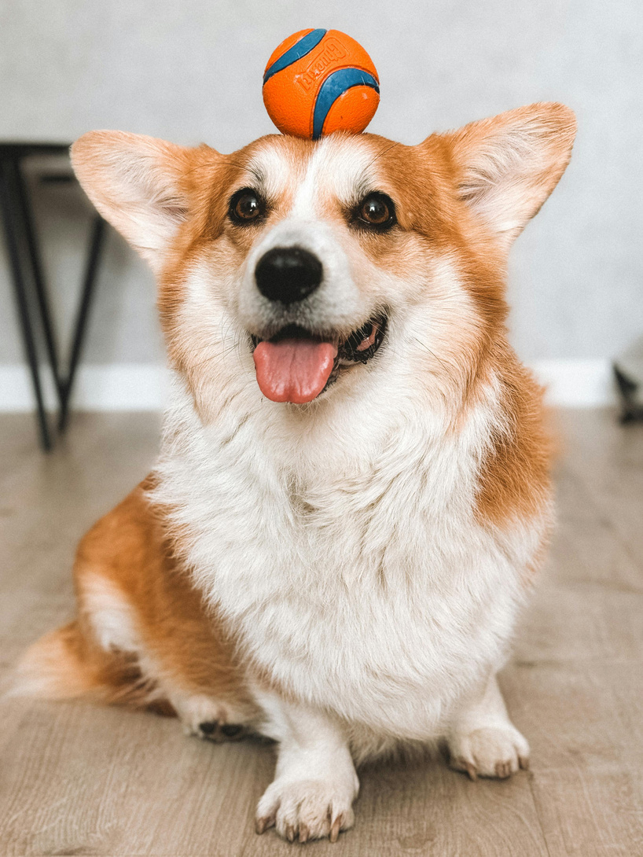
03
Pre-existing Services and APIs
Service | Role in DogExplorer
TheDogAPI | Breed database: weight, height, temperament, breed group, life span, description
SpeechState + Azure | Speech recognition and synthesis in the browser (en-US)
Ollama.llama3.1 | NLU to JSON, RAG answer generation, free replies to off-topic turns
Ollama.qwen3-embedding | 384-dimensional embeddings of breed texts and questions
Qdrant | Vector database for retrieval, filtered by breed
XState | State machine for the spoken turn loop
Notes:
I used several existing services.
TheDogAPI provides information about dog breeds.
SpeechState and Azure handle speech recognition and speech synthesis.
I use Ollama with Llama 3.1 for language understanding and generating answers, and Qwen for embeddings.
Qdrant stores the knowledge base, while XState controls the spoken conversation loop.

Slide 4
04
Scenario
A person who wants a dog, but doesn’t know which breed, describes what they need. The system fills in what is missing and suggests breeds.
User:
“I’m looking for a small, friendly dog that doesn’t need much grooming.”
System:
“How active would you like the dog to be?”
Size, temperament and grooming are given → only activity is still missing, so that is what the system asks.
Notes:
The main scenario is a person who wants a dog but doesn't know which breed to choose.
For example, the user says, 'I'm looking for a small, friendly dog that doesn't need much grooming.'
The system understands that size, temperament and grooming have already been provided. So instead of asking those questions again, it asks about the missing activity preference.

Slide 5
05
Collected material
Source | Content | Used for | Amount
TheDogAPI | Structured attributes, description, history | Matching + RAG | 630 breeds
Wikipedia | Care sections: temperament, health, grooming, exercise | RAG | 59 breeds
Test set | 23 breeds saved from TheDogAPI + scripted user utterances | Scenario tests | 23 breeds
Notes:
For data collection, I used two main sources.
From TheDogAPI, I collected information about 630 breeds, including their characteristics and descriptions.
I also collected Wikipedia information for 59 common breeds, focusing on topics like temperament, health, grooming and exercise.
"I used Wikipedia's official MediaWiki API to retrieve dog breed articles as plain text, processed the useful sections, and added them to my RAG knowledge base."
For testing, I used a smaller set of 23 breeds with scripted user utterances.

Slide 6
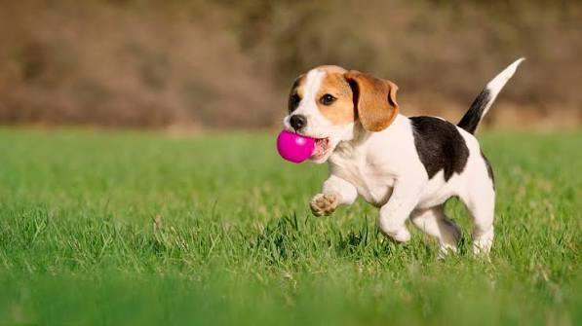
Example: Beagle
06
TheDogAPI
Wikipedia
Wikipedia
Temperament: Friendly, gentle, alert, outgoing, curious, energetic
Breed group: Hound
Life span: 10–15 years
Weight: 9–14 kg
Temperament:
The Beagle has an even temper and gentle disposition. Described in several breed standards as “merry”… Beagles are excellent with children.
Health:
A 2024 study in the UK found a life expectancy of 12.5 years… Beagles may be prone to epilepsy, but this can often be controlled with medication.
The API gives facts for matching; the texts answer “how” and “why” questions.
Notes:
Here is an example of the collected information for a Beagle.
TheDogAPI provides structured information, such as temperament, breed group, lifespan and weight.
Wikipedia provides more detailed descriptions, including information about behavior and health.
I use the API data mainly for matching and recommending breeds, while the additional texts are useful for answering more detailed questions.
So the two sources complement each other.

Slide 7
Sceniario to a Dialogue Design
07
User intents
Preference slots
Breed questions
set_preferences
show_results
more_options
select_result
ask_about_breed
general_question
restart · help
size: small, medium, large
activity: low, medium, high, any
grooming: low, medium, high, any
temperament: friendly, calm…
Operation: replace or add
description , size
temperament, lifespan
grooming, exercise
apartment, training
health, other
Notes:
After analyzing the scenario, I defined the different things users might want to do in the conversation.
For example, users can give preferences, request results, select a breed, ask questions, or restart.
I also defined preference slots for size, activity, grooming and temperament.
Following the SISU and IBiS approach from Lab 2, these intentions are converted into dialogue moves.
For example, 'I want a small dog' becomes an answer move, and 'show me some dogs' becomes a request-results move.

Slide 8
TheDogAPI has no activity or grooming fields
08
Users ask about exactly these two things, so the matcher estimates them from the words in each breed’s text.
Trait | Estimated from | Example signals
Size | Metric weight range | average weight → small / medium / large
Activity | Temperament, description, breed group | “energetic”, “athletic” ↑ · “calm”, “lap dog” ↓ · Sporting, Herding ↑ · Toy ↓
Grooming | Coat words in the description | “long”, “silky”, “curly” ↑ · “short”, “smooth” ↓ · “double”, “wiry” = medium
The estimate is also used to explain each result: “Miniature Schnauzer, small, very active, moderate grooming.”
Notes:
One problem I found during data analysis was that TheDogAPI doesn't provide activity or grooming levels directly.
But these are important preferences for choosing a dog.
So I implemented a rule-based method to estimate them.
For activity, I look for words like 'energetic' or 'calm' in the descriptions, and also consider the breed group.
For grooming, I look for coat-related words like 'long', 'curly' or 'short'.
These estimates are used both for matching breeds and explaining the recommendations.

Slide 9
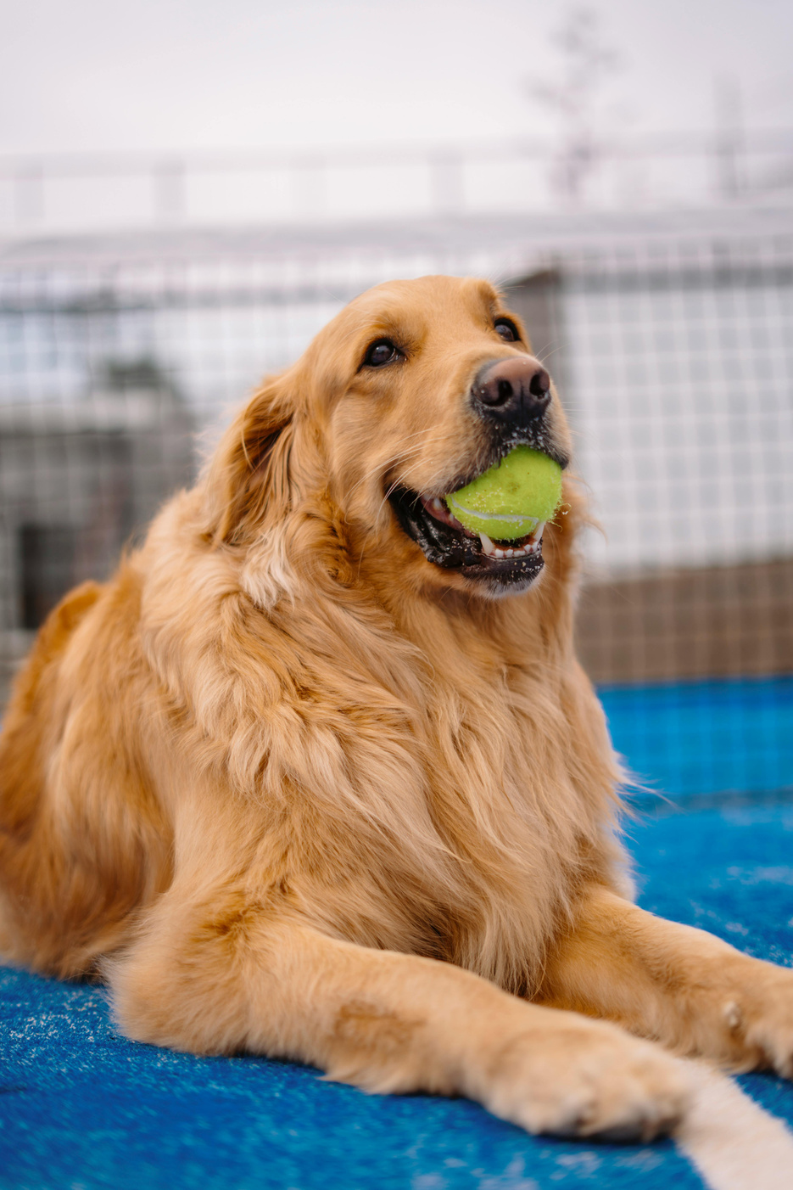
Architecture
09
Speech in
NLU
Update rules
NLG
Speech out
Azure ASR via SpeechState
Fixed phrases first, then llama3.1 → JSON
Integrate → Execute → Select, on the information state
System moves → text
Azure TTS
The Execute Step consults:
TheDogAPI
RAG (Qdrant)
LLM fallback
Search and rank breeds; size and life span answers
Grooming, exercise, health, training questions
Small talk and open questions; else repair
Notes:
This slide shows the architecture of my system.
First, the user speaks, and Azure Speech Recognition converts the speech into text.
Then the NLU component analyzes the utterance. It first checks predefined phrases, and if needed, it uses Llama 3.1 to identify the user's intent and preferences.
The NLU result is converted into user dialogue moves.
These moves are processed by the Dialogue Move Engine, which follows three stages.
Integrate updates the information state, Execute performs tasks such as searching for breeds or calling RAG, and Select decides what the system should say next.
Finally, NLG converts the selected system moves into natural-language text, and Azure speaks the response.
The information state is maintained across turns, so the system remembers the user's preferences and the current breed.

Slide 10
Retrieval for breed question
10
Indexing
Answering (each question)
  Fetch TheDogAPI and Wikipedia texts
  Split into 500-character chunks, 50 overlap
  Embed with qwen3-embedding (384 dims)
  Store in Qdrant with breed + source URL
  Embed the user’s question
  Top 4 chunks, filtered to the current breed
  llama3.1 answers from those chunks only
  No answer in the text → “I don’t have that information”
Notes:
For more detailed breed questions, I implemented Retrieval-Augmented Generation, or RAG.
There are two main stages: indexing and answering.
During indexing, I collect documents from TheDogAPI and Wikipedia, split them into chunks of about 500 characters with 50 characters of overlap, and generate embeddings using Qwen.
These embeddings are stored in Qdrant together with the breed name and source information.
When the user asks a question, the system creates an embedding for that question and retrieves up to four relevant chunks, filtered by the selected breed.
Llama 3.1 then generates an answer using those retrieved texts.
If the information isn't available, RAG returns no answer, and the system can use its structured breed information instead.

Slide 11
What it handles
, hard parts
11
Dialogues it can handle
Problems encountered
  Several preferences in one utterance
  Corrections that replace or add
  “I don’t mind” for the slot just asked
  “The second one”, “it”, “anything else?”
  Breed questions from the API or RAG
  Small talk via the LLM; repair, help, restart
  No activity/grooming in the API: word-based estimates can be wrong (“long ears” ≠ long coat)
  LLM NLU is slow and inconsistent on short answers: fixed phrases + last question as context
  RAG could invent answers: NO_ANSWER instead
Notes:
The system can handle different types of dialogues.
Users can provide several preferences together, change their preferences, request more results, and ask follow-up questions about selected breeds.
It can also handle small talk and misunderstandings.
During implementation, I encountered several challenges.
One was the missing activity and grooming fields in TheDogAPI, which I addressed using keyword-based estimates. However, these estimates aren't always accurate.
Another challenge was that LLM-based NLU could be slow or inconsistent for short answers, so I added predefined phrase handling and used the last question as context.
For RAG, I wanted to reduce unsupported answers, so I instructed the model to return a special NO_ANSWER value when the retrieved documents don't contain the answer.

Slide 12
What would improve the system
12
Test with real users
Record real dialogues and see where the NLU and the questions fail.
Better trait data
Use rated energy and grooming levels instead of word estimates.
Compare breeds
“Which is calmer, the Beagle or the Whippet?”
More slots and more texts
Children, other pets, Wikipedia for more breeds.
Notes:
There are several ways I could improve this project.
First, I would test the system with real users and collect natural conversations. This would help identify problems in speech recognition, language understanding and dialogue flow.
Second, I would improve the recommendation algorithm by using more reliable activity and grooming data instead of only keyword-based estimates.
Third, I would improve breed comparisons, so users could ask questions like 'Which is calmer, a Beagle or a Whippet?' and receive more structured comparisons.
Finally, I would add more preference categories, such as suitability for children, other pets and apartment living, and expand the knowledge base.

Slide 13
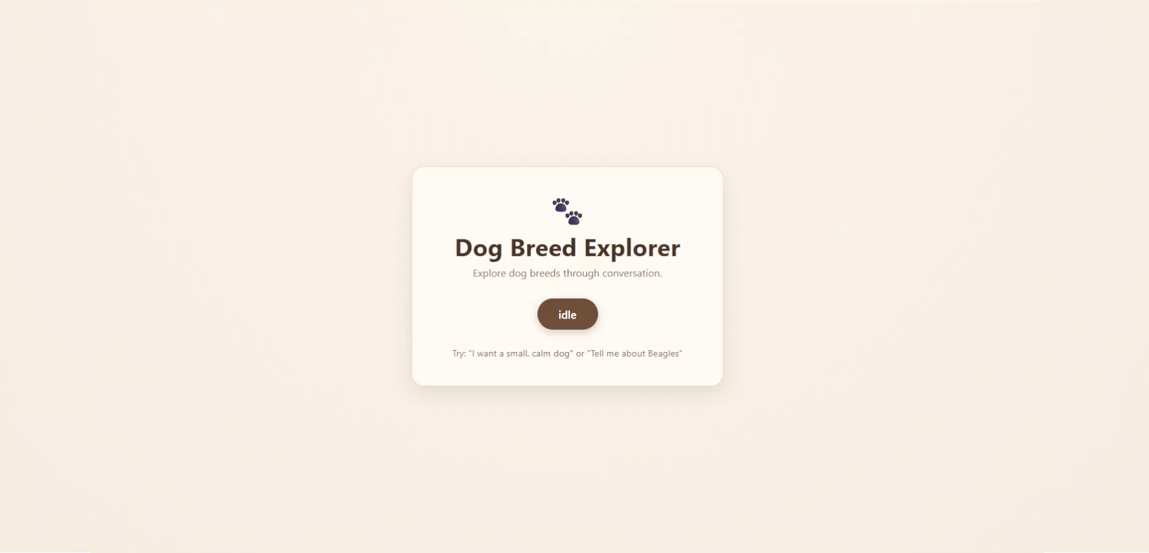
Demo
13
Notes:
For more detailed breed questions, I implemented Retrieval-Augmented Generation, or RAG.
There are two main stages: indexing and answering.
During indexing, I collect documents from TheDogAPI and Wikipedia, split them into chunks of about 500 characters with 50 characters of overlap, and generate embeddings using Qwen.
These embeddings are stored in Qdrant together with the breed name and source information.
When the user asks a question, the system creates an embedding for that question and retrieves up to four relevant chunks, filtered by the selected breed.
Llama 3.1 then generates an answer using those retrieved texts.
If the information isn't available, RAG returns no answer, and the system can use its structured breed information instead.

Slide 14
Thank You!

